Slide 1


GAYATRI VIDYA PARISHAD
COLLEGE FOR DEGREE AND PG COURSES (A)
DEPARTMENT OF COMPUTER SCIENCE & COMPUTER APPLICATIONS
DESIGN OF PORTABLE LAND PARAMETER MEASURING DEVICE ON MACHINE LEARNING USING IoT
By
D.PRASANTH KUMAR
PG232406003
(2023-25)
SEM-IV
Project Guide:
Mr.B.DIVAKAR
Assistant professor
Department of Computer Science

Slide 2
CONTENTS
Introduction
Problem Statement
Objectives
Components
Software Requirements
System Overview
Results & Observations
Advantages & Limitations
Conclusion

Slide 3
Introduction
Land conditions play a key role in farming and crop selection.
Important land parameters like soil moisture, temperature, pH, and EC help us understand soil health.
Traditional methods to check these are slow, expensive, and not portable.
There is a need for a smart, low-cost device that gives instant readings.
This project introduces a portable device that collects land and soil data using sensors.
The data is processed using Machine Learning to predict pH, EC, soil type, and suitable crops.
Results are shown on an LCD screen and can also be viewed online through a web page.

Slide 4
Problem statement
Farmers often don’t have quick access to soil health information before starting cultivation.
Traditional soil testing methods are time-consuming, costly, and require lab support.
Many rural areas lack proper soil analysis tools that are easy to use in the field.
There is no compact, low-cost device that shows real-time soil data and crop suggestions.

Slide 5
objectives
To design a smart device that measures key land/soil parameters using sensors.
To predict important values like pH, EC, and soil type using Machine Learning.
To suggest the most suitable crop based on real-time data.
To display results on an LCD screen and a web-based interface.
To create a system that is portable, affordable, and easy to use for farmers.

Slide 6
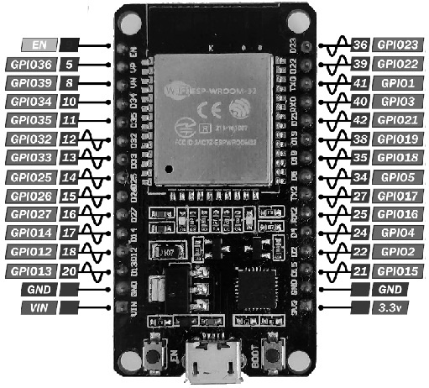
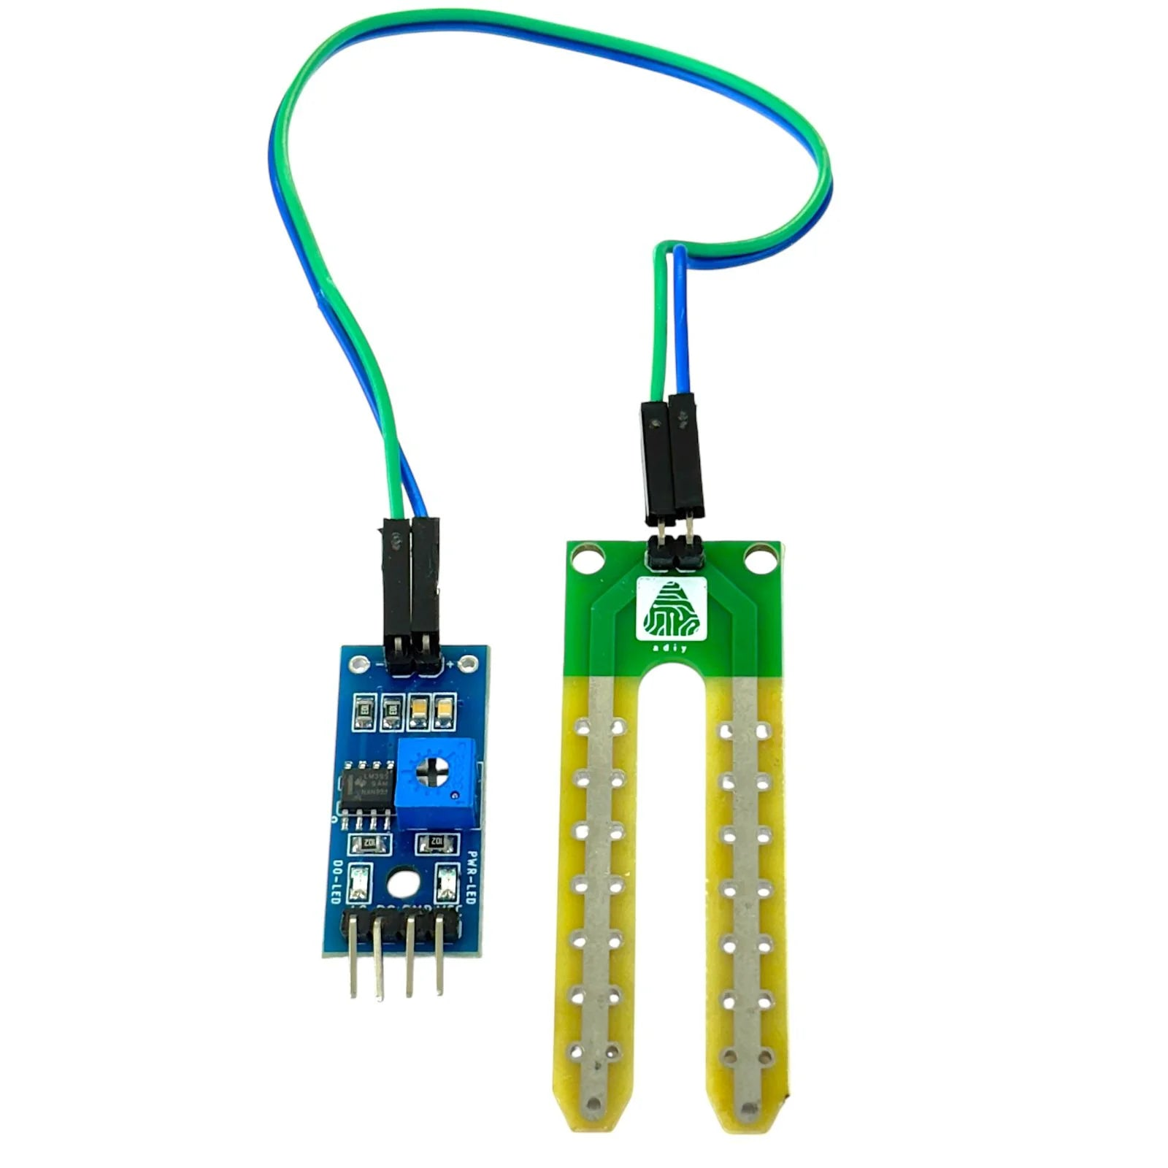
Components
1. ESP32 Microcontroller – A small computer that controls sensors and processes data.
Use: Collects sensor data, processes it, and sends it wirelessly via Wi-Fi/Bluetooth.
2. Soil Moisture Sensor – Measures water content in the soil.
Use: Helps farmers decide when to water crops, preventing overwatering or dryness.

Slide 7
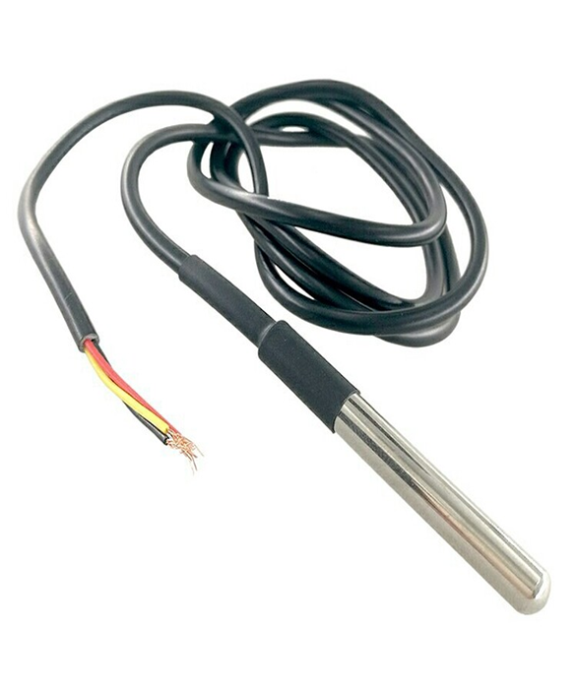
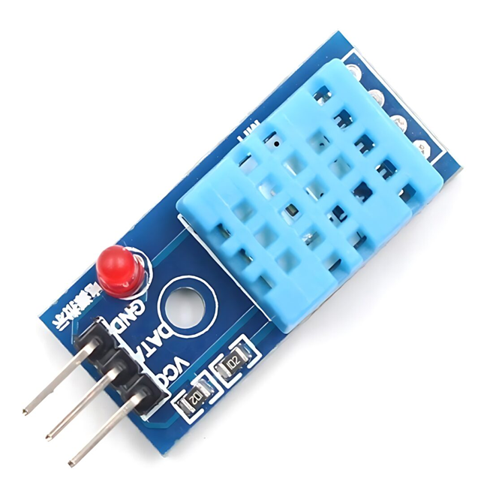
3. Soil Temperature Sensor – Checks the temperature of the soil.
Use: Helps in planting crops at the right time and managing soil conditions.
4. Humidity & Temperature Sensor – Detects air moisture and temperature.
Use: Helps in monitoring weather conditions and preventing plant diseases.

Slide 8
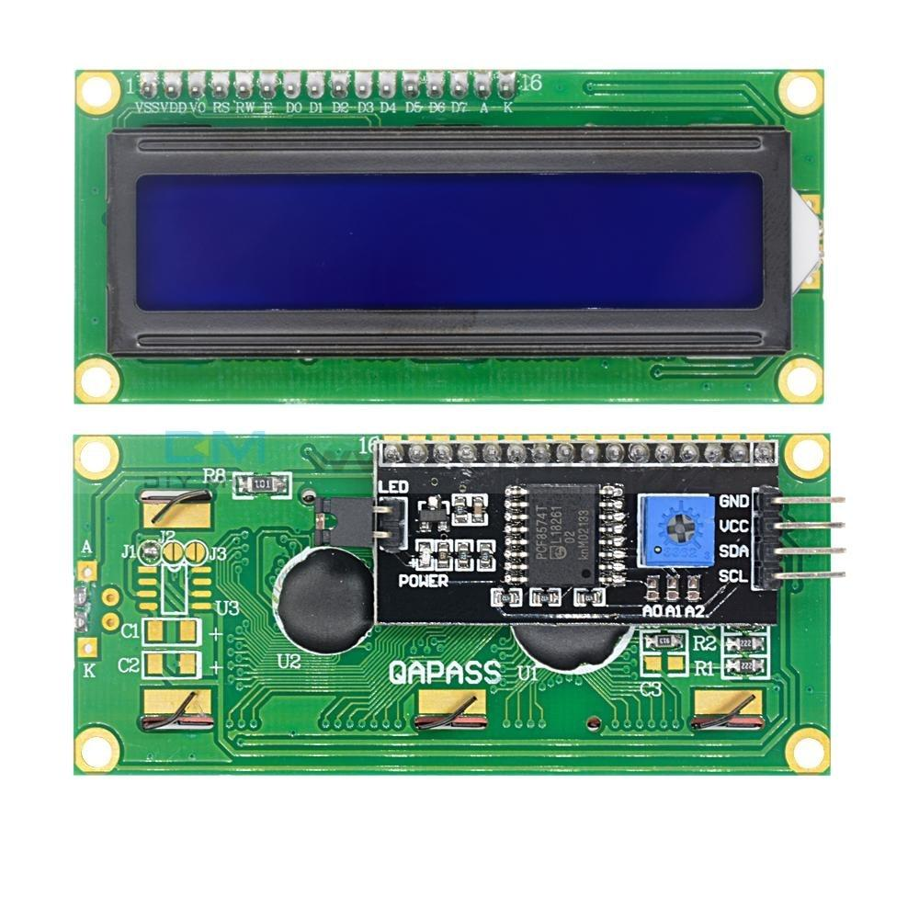
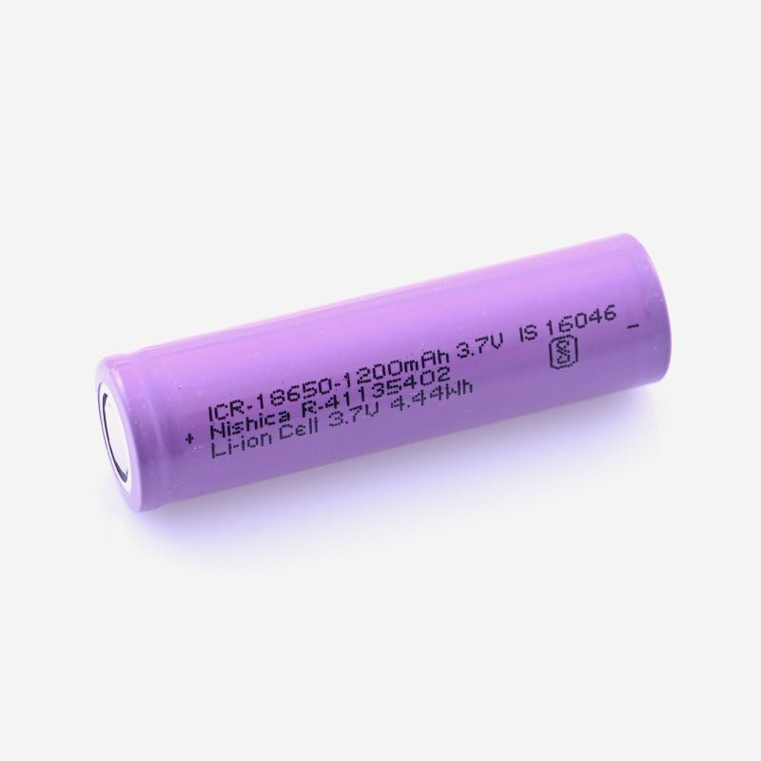
5. 16x2 I2C Display – A display module that shows 16 characters per line on 2 lines, connected via I2C protocol.
Use: Shows sensor values and ML predictions clearly, one-by-one.
6. 3.7V Li-ion Battery - A rechargeable battery that serves as the portable power source.
Use: Powers all components when operating in the field without USB.

Slide 9
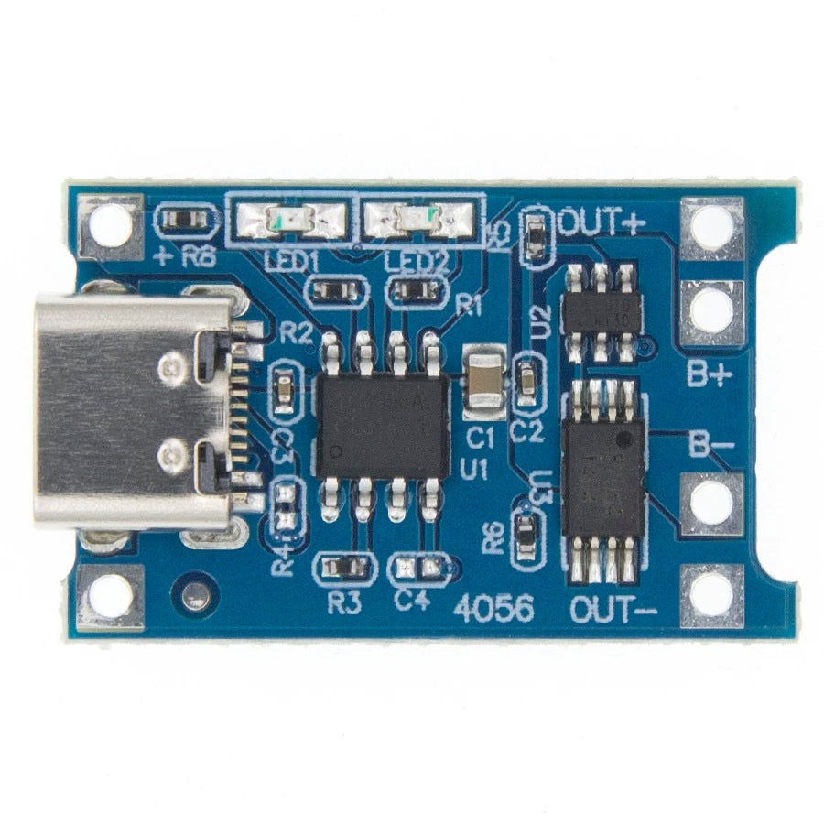
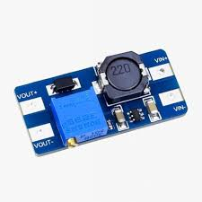
7. TP4056 Charging Module – A battery charging module with micro-USB input for safe charging of Li-ion batteries.
Use: Manages battery charging and prevents overcharging or damage.
8. MT3608 Boost Converter - A voltage step-up module that increases 3.7V battery power to 5V.
Use: Ensures ESP32 and sensors get sufficient voltage to function properly.

Slide 10
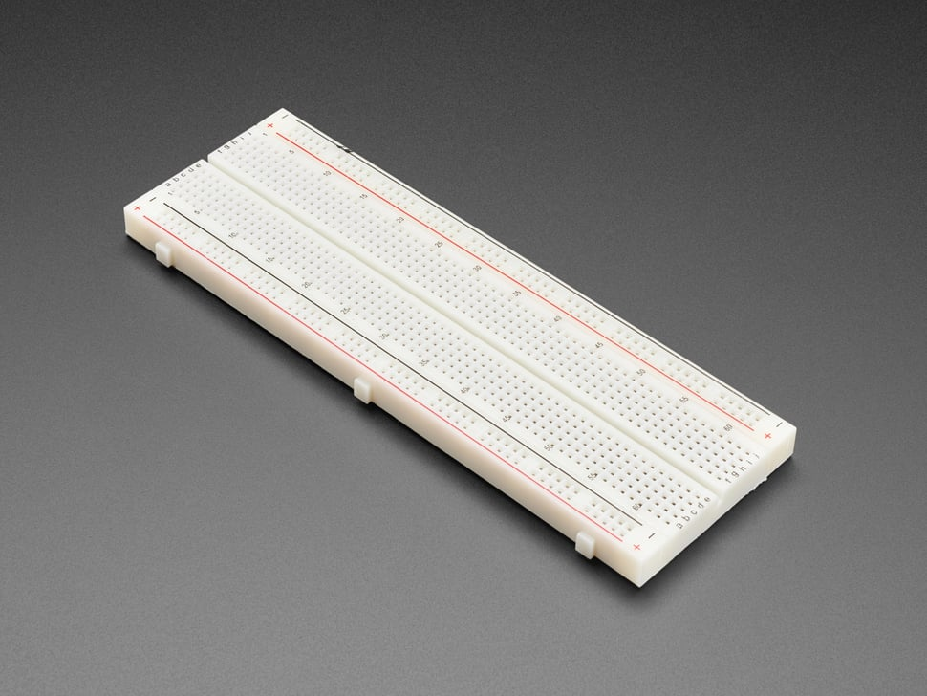
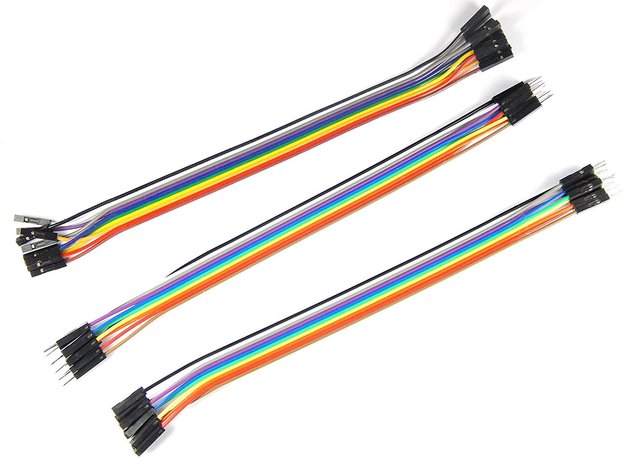
9. Breadboard – A reusable prototyping board used to make temporary circuit connections without soldering.
Use: Connects ESP32, sensors, and other modules for testing and final setup.
10. Jumper Wires - Flexible wires with pin connectors used for making electrical connections.
Use: Connect different components (sensors, ESP32, LCD, etc.) on the breadboard.

Slide 11
Software requirements
1. Arduino IDE -
Use: Programming and uploading code to the ESP32 microcontroller.
Why: Compatible with ESP32 libraries, sensor libraries, and easy serial monitoring.
2. Python -
Use: For backend development and running Machine Learning models.
Why: Used to write the Flask server and handle ML model predictions.
3. Flask (Python Framework) -
Use: Creates REST API endpoints (/predict, /latest) for ESP32 communication.
Why: Lightweight and perfect for small-scale IoT applications.

Slide 12
Software requirements
4. PythonAnywhere -
Use: Cloud hosting platform for deploying the Flask server.
Why: Makes the device portable and accessible from any location.
5. Visual Studio Code (VS Code) -
Use: Used for developing Python ML scripts and backend code.
Why: Powerful code editor with extensions for Python, Flask, and Git integration.
6. Frontend (HTML + JavaScript) -
Use: Displays real-time sensor and prediction data from Flask’s /latest endpoint.
Why: Enables live monitoring on any web browser or device.

Slide 13
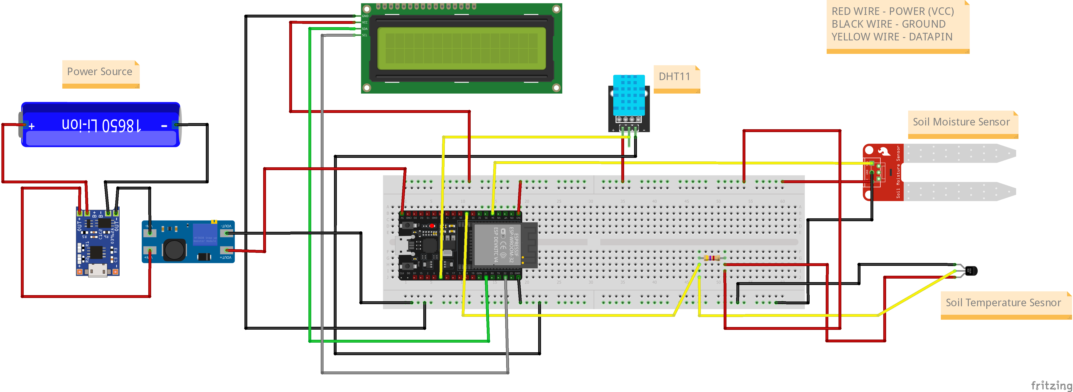
System overview
Hardware System Overview

Slide 14
1. Power Supply System:
The device is powered using a 3.7V Li-ion battery (commonly used rechargeable battery).
Since ESP32 and sensors need higher voltage (around 5V), a Boost Converter (MT3608) is used to step up 3.7V to 5V.
A TP4056 module is used to charge the battery safely and control overcharging.
A switch is placed after the Battery to turn the system ON or OFF manually.
This power system provides required voltage to all connected components: ESP32, sensors, and LCD display.

Slide 15
2. Sensor Data Collection:
Soil Moisture Sensor → Measures soil moisture (analog)
DHT11 Sensor → Measures ambient temperature and humidity
DS18B20 Sensor → Measures soil temperature (digital)
3. ESP32 (Data Handling & Communication):
ESP32 reads values from all the sensors.
Uses WiFiManager to automatically connect to saved Wi-Fi or open hotspot for new Wi-Fi configuration.
Formats sensor readings into JSON format.

Slide 16
Sends the sensor data to a Flask server via HTTP POST request to the /predict endpoint.
Waits for the server to return the predicted results like pH, EC, Soil Type, and Suitable Crop.
4, Cloud Hosting (PythonAnywhere – Flask Server)
Flask server hosted in the cloud
Receives sensor data at /predict endpoint
Enables predictions from anywhere (IoT portability)

Slide 17
5. Machine Learning Predictions
Server loads 4 trained ML models:
  pH_model.pkl – predicts Soil pH
  EC_model.pkl – predicts Soil EC
  soil_type_model.pkl – predicts Soil Type
  crop_model.pkl – predicts Suitable Crop
Sends prediction back as JSON response
Also updates /latest endpoint for web dashboard
Appends data to live CSV dataset

Slide 18
6. Output Display
ESP32 receives response
Displays each value one-by-one on 16x2 LCD
Also updates data on frontend via /latest endpoint

Slide 19
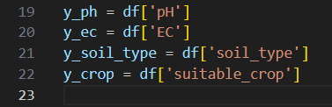
Machine Learning Overview:
This project uses Machine Learning models to predict: Soil pH, Soil Electrical Conductivity (EC), Soil Type, Suitable Crop
Input:
Output to predict:
We train models with respect to the sensor readings which helps in predictions. The models created will be like – pH_model.pkl, EC_model.pkl, soil_type_model.pkl, crop_model.pkl .

Slide 20
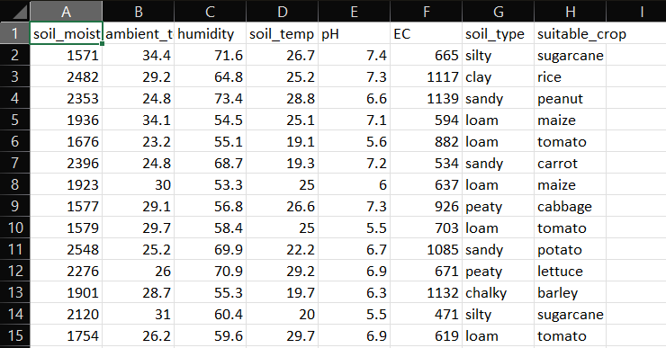
Dataset used for Training:
Total rows: e.g., ~200+ data points
Columns:
  Features: Soil Moisture, Ambient Temp, Humidity, Soil Temp
  Targets/Labels: pH, EC, Soil Type, Suitable Crop

Slide 21
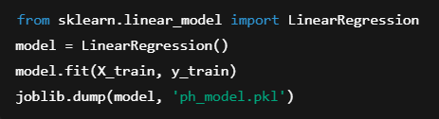
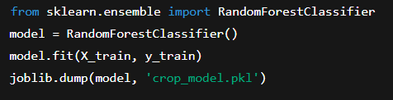
Model Building:
We trained 4 separate Machine Learning models to make predictions:
Regression Models:
  Linear Regression → Predicts Soil pH
  Linear Regression → Predicts Soil EC (Electrical Conductivity)
Classification Models:
  Random Forest Classifier → Predicts Soil Type
  Random Forest Classifier → Predicts Suitable Crop

Slide 22
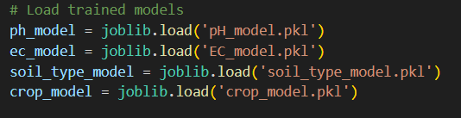
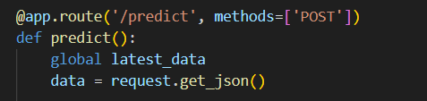
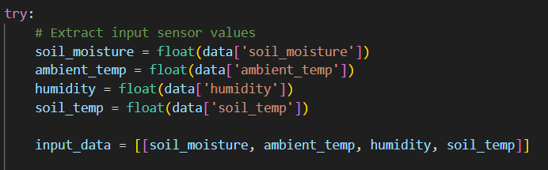
Flask Server Overview:
We load all the models which we trained and created
Extracts Input Sensor values which ESP32 sent via HTTP POST request to flask server at /predict endpoint
  ESP32 sends (POST) sensor data , and server receives and processes it
  Server then predicts pH, EC, Soil type, and crop
  Server responds with prediction in JSON

Slide 23
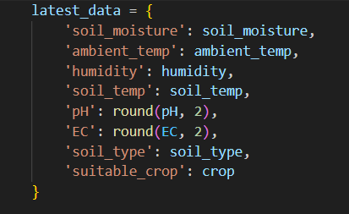
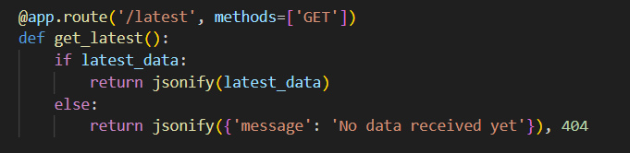
After sending the data and prediction is made:
The server stores it in the latest_data dictionary
Later, other devices (like in frontend/browser)
might want to just see the latest prediction
For that:
They make a GET request to /latest endpoint
No input is needed from them
They are simply retrieving previously saved
data

Slide 24
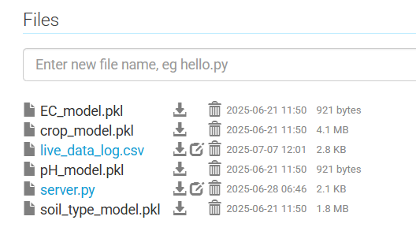
/predict – POST request (HTTP method) It was called by ESP32 to send the sensor data. Server uses ML models to predict and return data
/latest – GET request (HTTP method) It was called by browser to get the latest prediction. It just returns the last prediction in memory
We deploy our flask server and models in Cloud(Python anywhere) such that we can run our server all the time and it makes predictions and returns the values

Slide 25
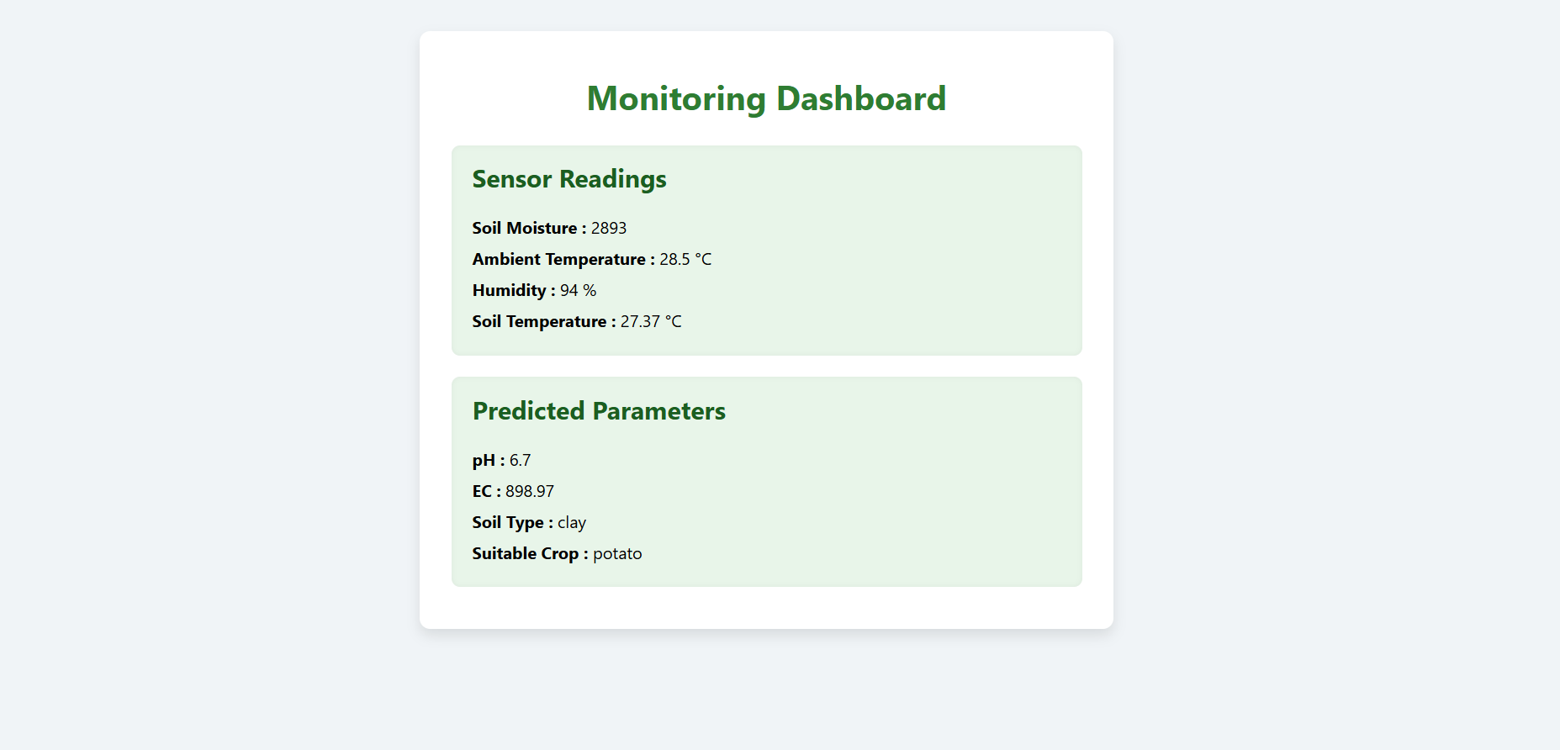
Real-time Web Dashboard:
HTML + JavaScript frontend page
Displays live values in a clean layout
Automatically refreshes data every few seconds
2. Fetches data from Flask server using:
GET request to /latest endpoint
Displays the most recently predicted values

Slide 26
Results and observations
Live Predictions Observed:
The system successfully predicts and displays:
  Soil pH (e.g., 6.5 – slightly acidic)
  Electrical Conductivity (EC) (e.g., 980 µS/cm – moderate)
  Soil Type (e.g., Sandy, Loamy)
  Suitable Crop (e.g., Tomato, Banana)
Real-Time Data Logging:
Every prediction is:
  Shown on LCD
  Shown on web page
  Stored in a CSV file for historical analysis

Slide 27
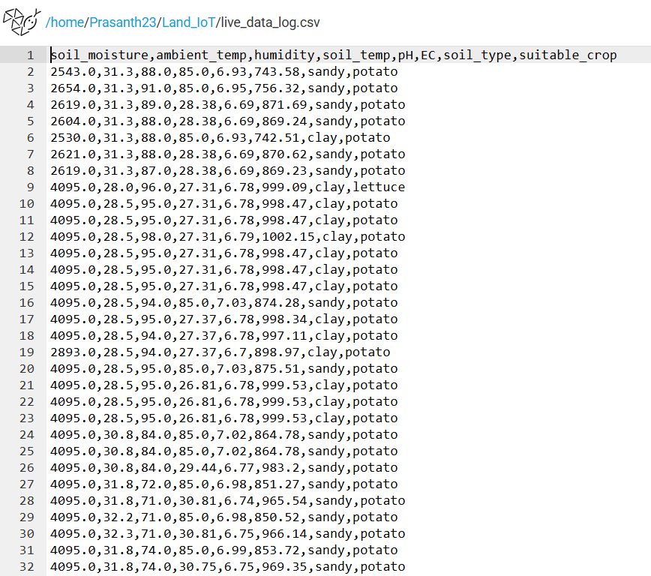
Real Time Data Logging CSV File
The sensor readings and predictions which are collected and calculated will be appended in this csv file for live data (historical data)

Slide 28
Advantages & limitations
Advantages:
Portability: Compact, battery-powered usable in fields without direct power.
Automation: Real-time data processing and ML-based prediction without manual effort.
Multi-Parameter Analysis: Measures multiple land/soil parameters in one device.
Ease of Use: User-friendly display and web interface.
Wi-Fi Flexibility: WiFiManager allows easy connection to any hotspot.
Data Logging: Stores readings in CSV format for future reference or analysis.

Slide 29
Limitations:
Internet Dependency: Requires internet access to communicate with the cloud server.
Battery Runtime: Power management needed for long field operations (depends on battery + load).
Limited Screen Space: 16x2 LCD shows only 1 parameter at a time — takes time to loop through.

Slide 30
conclusion
This project presents a compact and portable land parameter measuring device using IoT and machine learning. It collects real-time data from sensors and sends it to a cloud server using ESP32. The Flask server uses trained machine learning models to predict pH, EC, soil type, and suitable crop. Results are displayed on an LCD screen and a web dashboard, offering a smart and low-cost solution to support better farming decisions.

